Slide 1

INTRO TO WEB DEVELOPMENT
DESIGN INSPIRATION
Alejandra Arevalo

Slide 2


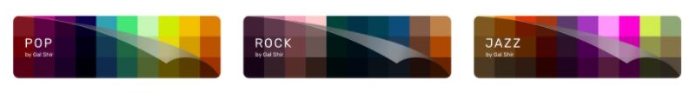
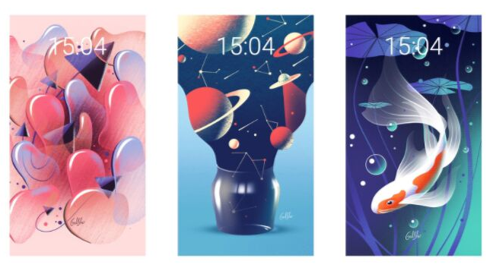
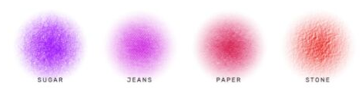

Digital Artist
GAL SHIR
palettes
artwork
brushes
procreate

Slide 3





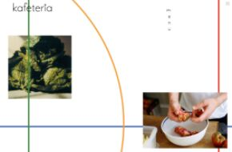
STEFANIE BRUCKLER
web design
Graphic Designer
branding

Slide 4
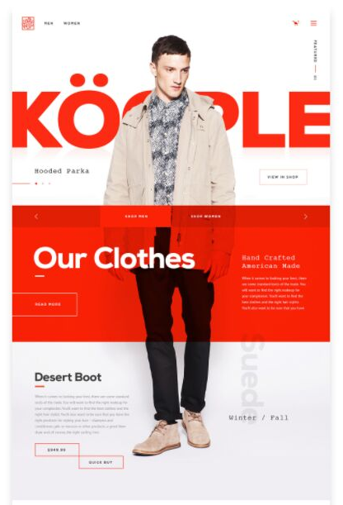

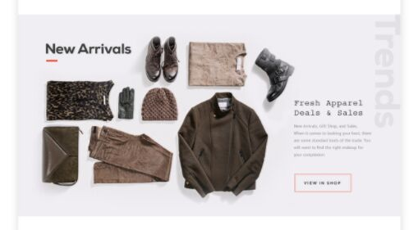
ALEX COVEN
Web Developer
web design

